Slide 1
La Clase Mágica (LCM) y la Comunidad
La Colonia de Eden Gardens, Inc. Foundation
Solana Beach, California (LCEG)

Slide 2
La Clase Mágica y la Comunidad Diversity at work in a safe place.

Slide 3
LCEG Mission: To support (help) youth and families to achieve their dreams by facilitating unified community collaborations that create positive change.
LCM Program Goal: To serve the educational and social needs our underserved youth and families in a culturally sensitive and compassionate manner.
“Be the change you want to see in the world.”
Outcome: To bring educational resources such as technology, fun curriculum, and college students to help children bridge many of the learning barriers minority populations face in the 21st century in a safe learning environment for a group of youngsters with big dreams.

Slide 4
La Clase Mágica y la Comunidad
Sub-Goals:
Provide a safe environment to support “intergenerational learning”, problem solving, communications and relationship building.
Build self esteem and confidence in our kiddos
Provide parenting guidance and connections
Bring together sectors of the community to work together closely, especially with our
Build longer term sustainability

Slide 5
La Clase Mágica y La Comunidad - History
LCM previously under the of leadership of UCSD School of Communications and Dr. Olga Vasquez, (recently retired) for the past 30 years.
Founded at St. Leo’s Mission in La Colonia de Eden Gardens at the altar.
Mission Circle volunteers have been tutors for kiddos since the 2001.
LCM is a vibrant and vital community resource
Our comunidad has a responsibility to cherish and protect this
precious jewel.

Slide 6
LCEG Accomplishments Towards Needs Assessment Findings
2014: Collaborated and conducted a “first-ever” Community Needs Assessment Findings with California State University San Marcos and Santa Fe Christian Schools
Met with key stakeholders in our community as well as residents to ask them what they believe that our community needs are
Findings…

Slide 7
La Colonia de Eden Gardens Community Needs Assessment
Key Findings:
Area 1 – Children and Youth: Assess the resources and opportunities for children and youth in education, after-school programs, and youth leadership.
Area 2 – Family and Civic Engagement: Assess the resources and opportunities for parents and families to actively participate in education and the civic affairs of their community.
Area 3 – Social Capital and Community Identity: Assess the opportunities and resources for celebrating and preserving the community’s culture and history.

Slide 8
La Colonia de Eden Gardens Needs Assessment
Needs Assessment Key Findings Recommendations:
Children and Youth: Continue to work with local schools in creating systems for better quality of education - Ongoing
Family and Civic Engagement: Work with our neighbors towards empowering them in our community - Ongoing
Social Capital and Community Identity :La Colonia residents recommend continuing to host cultural events and festivals. Music, food and a variety of cultural activities. Cultural events have socio-cultural and economic benefits for the community– Dia de los Muertos
Social Capital and Community Identity: La Colonia residents recommend creating a cultural center or community space to feature and preserve community history. Promoting cultural diversity will build community cohesion. TBD

Slide 9
La Clase Mágica y la Comunidad
Core Values:
Love
Respect
Kindness
Compassion/Acceptance
Fun & Creative Environment
Nurturing environment
Everyone can be themselves
Important Factors:
Parents w/undocumented immigration Status
Absence of a Living Wage
Lack of affordable housing
Home instability
Gentrification occurring
Families experiencing financial hardships
Non-denominational

Slide 10
La Clase Mágica y La Comunidad
1on1 Tutoring
Westview High School Robotics Program

Slide 11
La Clase Mágica y la Comunidad
Current dynamics:
A few years ago, LCEG Board was asked by Olga to become the LCM Community Steward
St. James-St. Leo Catholic Community hosts our program at St. Leo’s Kitchen
UCSD and Olga no longer formally part of LCM
Everyone feels protected in a safe place, especially our kiddos!
Comunidad/Community involvement and participation
Parent ownership/leadership development
Youth leadership development

Slide 12
La Clase Mágica y la Comunidad
Current dynamics:
Easter Seals disinvited LCM use of Head Start facilities – “Turning lemons into lemonade”
Program participants chose to stay in St. Leo’s Kitchen when presented with an opportunity to move to a larger and newer space at St. James Parish
Holy ground!!! LCM was born at the altar of St. Leo’s Mission
Good energy!
Everyone is having fun!
Everyone feels welcome and at home
Working towards increased sustainability

Slide 13
La Clase Mágica y la Comunidad
How is LCM Different from other after-school programs?
Welcome all youth and families free of charge
Open door/Inclusive for all youth
Fills the gap of programs with stricter participation guidelines
Students & tutors have access to the Internet and school systems for curriculum, homework, grades, research, etc.
All types of learners are welcome and supported
Use of games for problems solving
Robotics component
All components support LCM student learning

Slide 14
La Clase Mágica y la Comunidad
Success factors:
Intergenerational learning
Safe place for our youth
Strong leadership: Site Coordinator and Assistant Site Coordinator
Mission Circle Volunteers: “We receive way more than we give.”
Parent support and involvement
Monthly Parenting Class, i.e., Pláticas de Mejorar
Community stewardship model
Staff deserve a living wage
Vision to sustain and nurture

Slide 15
La Clase Mágica y la Comunidad
Jan & Jose Playing Checkers Developing Math/ Problem Solving Skills
Making Halloween Crafts

Slide 16
La Clase Mágica y la Comunidad
Success factors:
Fund development capabilities are growing
Strong community collaboration:
St. James-St. Leo Catholic Community
St. James Mission Circle
MiraCosta College Service Learning Program
Westview High School Robotic Program
Parents: Campus Supervisors
Very cost-effective programming

Slide 17
La Clase Mágica y la Comunidad
Future considerations:
LCM Alumni and current member celebration
More effective use of:
Publicity
Social media
LCEG Website
Direct mail
One-on-one meetings with funders

Slide 18
LCEG Accomplishments to date:
2016-2017: Provided over $9,000.00 in college and university scholarships to local youth
2017: Sponsored “First-ever” Latino Culture Frutos de America Morena Photo Art Exhibit at Solana Beach City Hall by Ms. Karla Ranger Trujillo
2017 – Current: Community steward of UCSD La Clase Magica program at St. Leo’s Headstart location
2018: Blooms of Brown America Photo Art Exhibit at SB Library by Ms. Karla Ranger Trujillo
2018: Collaborating on a Parent Support Group with the Disconnect Collective called “Platicas Para Emejorar” (Talks to Improve Myself) in conjunction with St. James and St. Leo’s Catholic Community
2018: Assumed stewardship of LCM with an eye on towards the future of our youth and families
Note: As of 2018: At least 14 of our youth/H.S. Seniors have gone to college or university

Slide 19
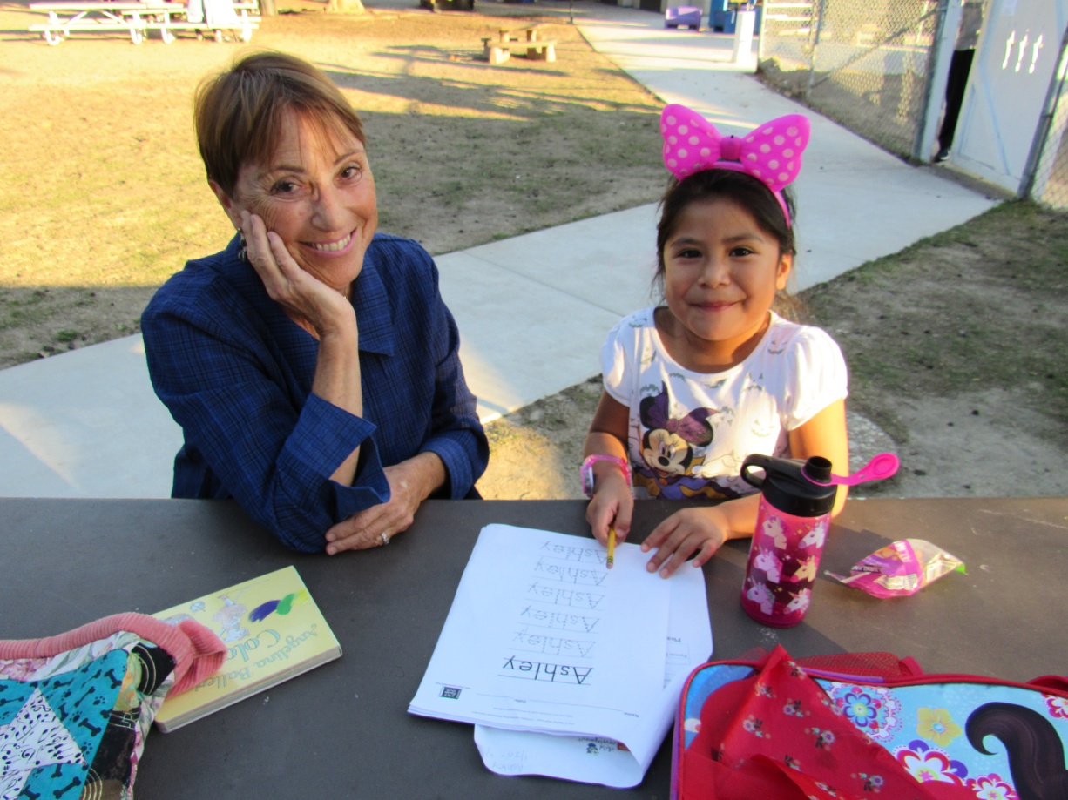
La Clase Mágica y la Comunidad
Q&A

Slide 20
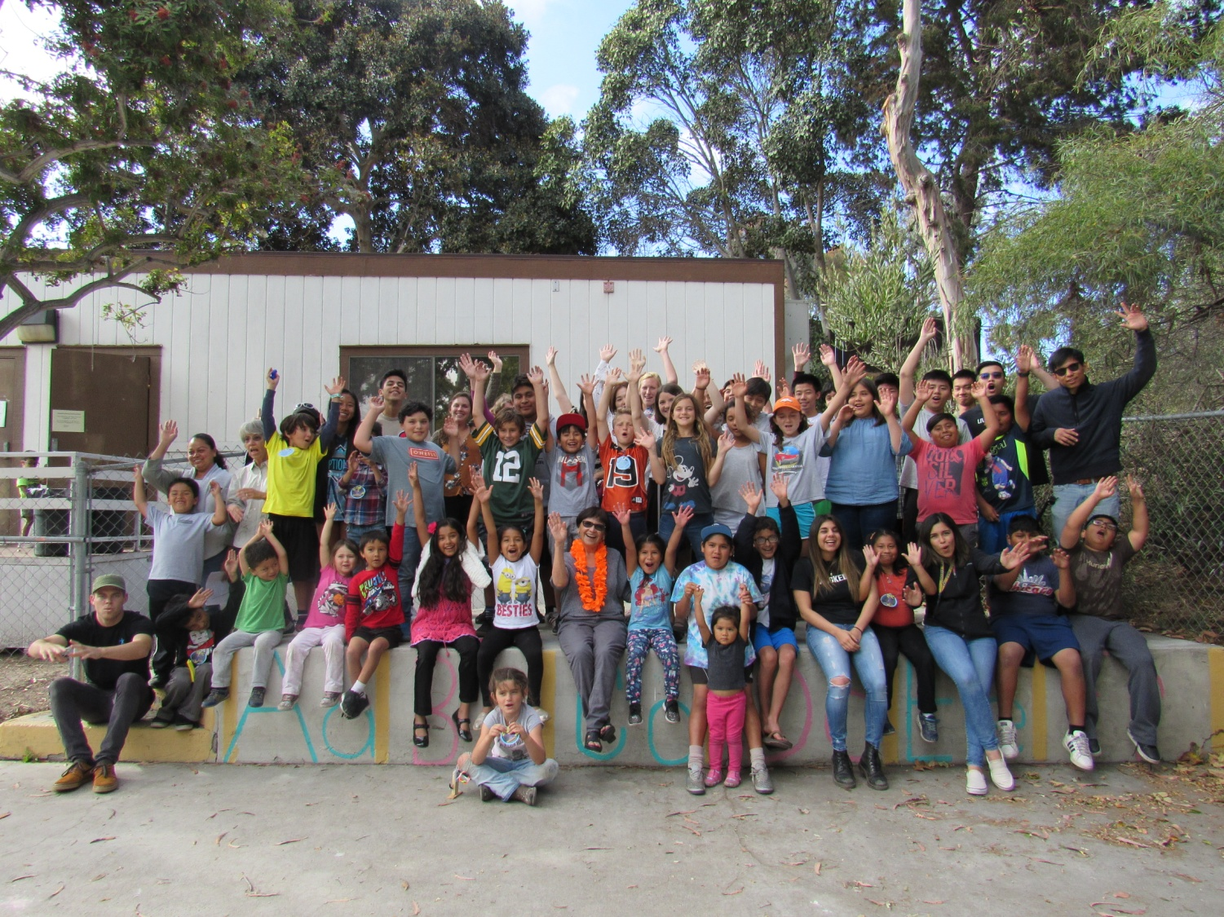
La Clase Mágica y la Comunidad Thank You!

